Slide 1
Joseph Slattery
Executive Vice President & CFO
Ladenburg Thalmann Conference
September 26, 2017

Slide 2
Forward Looking Statements
This presentation includes statements relating to TransEnterix’s current regulatory and commercialization plans for our products, the Senhance™ Surgical Robotic System and the SurgiBot™ System. These statements and other statements regarding our future plans and goals constitute "forward-looking statements" within the meaning of Section 27A of the Securities Act of 1933 and Section 21E of the Securities Exchange Act of 1934, and are intended to qualify for the safe harbor from liability established by the Private Securities Litigation Reform Act of 1995. Such statements are subject to risks and uncertainties that are often difficult to predict, are beyond our control, and which may cause results to differ materially from expectations. Factors that could cause our results to differ materially from those described include, but are not limited to, whether the commercialization of the Senhance Surgical Robotics System will be successful, whether and when we will prepare a 510(k) submission for the Senhance Surgical Robotic System, the pace of adoption of our products by surgeons, the success and market opportunity of our products, our current cash reach, the effect on our business of existing and new regulatory requirements and other economic and competitive factors. For a discussion of the most significant risks and uncertainties associated with TransEnterix's business, please review our filings with the Securities and Exchange Commission (SEC), including our including our Annual Report on Form 10-K filed on March 6, 2017 and other filings we make with the SEC. You are cautioned not to place undue reliance on these forward looking statements, which are based on our expectations as of the date of this presentation and speak only as of the origination date of the presentation. We undertake no obligation to publicly update or revise any forward-looking statement, whether as a result of new information, future events or otherwise.

Slide 3
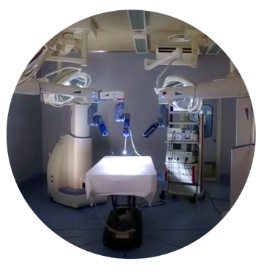
TransEnterix: TRXC
Focus: Surgical Robotics
Compelling Platform Technology
  Senhance Surgical Robot
  Robotic benefits with responsible economics
Significant addressable market opportunity
  Surgical robotics growing but minimally penetrated
Recent highlights
  Completed final FDA response for US submission process
  Expanded portfolio to include 3mm micro instruments and leading vision systems
  Sold first unit into Japan
Notes:
Updated “recent highlights”

Slide 4

Senhance Robotic System

Slide 5
Surgical Robotics Poised for Growth
Abdominal Robotic Surgery Market Size
$10.5 Billion
in 2021
Procedure expansion, geographic expansion and new entrants will grow abdominal robotic surgery market significantly
$2.7 Billion
in 2016
Source: Abdominal Surgical Robots Market Shares, Strategies, and Forecasts, Worldwide, 2015 to 2021 WinterGreen Research, December 2015

Slide 6
Benefits of Surgical Robotics
Increased surgeon ergonomics
Enhanced precision and control
Advanced visualization
Patient attractiveness
Benefits of Surgical Robotics
Consolidation of volume & surgeon recruitment

Slide 7
Robotic Surgery Landscape
Open Surgery
4 MM procedures
EU & U.S.
Laparoscopic Surgery
6 MM procedures EU & U.S.
Current abdominal robotic surgery
0.6 MM procedures
EU & U.S.
Sources: Intuitive Surgical Investor Slides, TRXC Estimates and Millennium Research Group
Historical Growth Drivers:
Convert open surgeries to robotics
Clinical and patient benefits have come from converting an open procedure to a minimally-invasive surgical approach
Offset signficant per-procedure cost increase with length of stay benefit vs. open surgery
Conversion of laparoscopy to robotics difficult due to substantial per-procedure cost increase

Slide 8

Robotic Surgery Landscape
Open Surgery
4 MM procedures
EU & U.S.
Laparoscopic Surgery
6 MM procedures EU & U.S.
Sources: Intuitive Surgical Investor Slides, TRXC Estimates and Millennium Research Group
Future Growth Drivers:
Convert laparoscopic surgeries to robotics
Opportunities to improve laparoscopy: greater precision, surgeon control of vision, better ergonomics, reduced need for assistance
Provide meaningful robotic benefits to laparoscopic surgery without significant per-procedure cost increase

Slide 9
Robotic Adoption Remains Low
Traditional laparoscopy remains the dominant form of minimally invasive surgery
Over 6 million laparoscopic procedures across US and CE Mark countries
Surgeons are experienced with approach, technique and instrument motion
Benefits
Trade-offs
Limited adoption
Accessing the benefits of robotics has required accepting trade-offs that can’t always be justified with competing systems
Robotic
Laparoscopic
Other
Notes:
In order to participate in the next wave of robotics, you are going to have to convert laparoscopy. And for that, you will need additional benefits with fewer trade-offs. So let’s talk about the trade-offs of competing systems…(next slide)

Slide 10
Trade-offs of Competing Systems
Lengthy set
up time
Larger incisions
Disengaged from surgical team
No haptic feedback
Trade-offs
v.
Laparoscopy
High procedure costs
Notes:
Transition to next slide: “So now let me talk about our platform, and how we offer the benefits of robotics without the trade-offs of competing systems.”

Slide 11

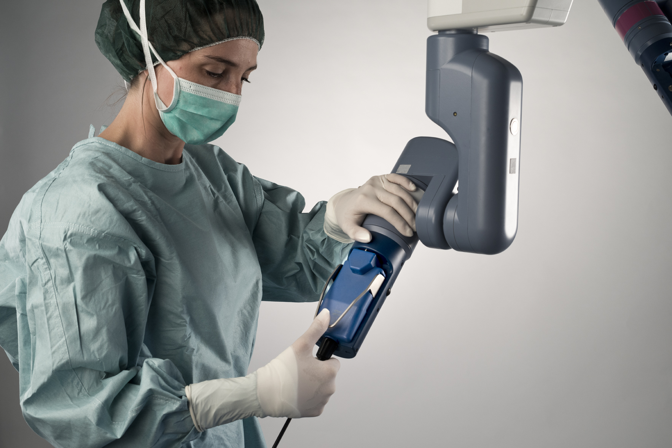


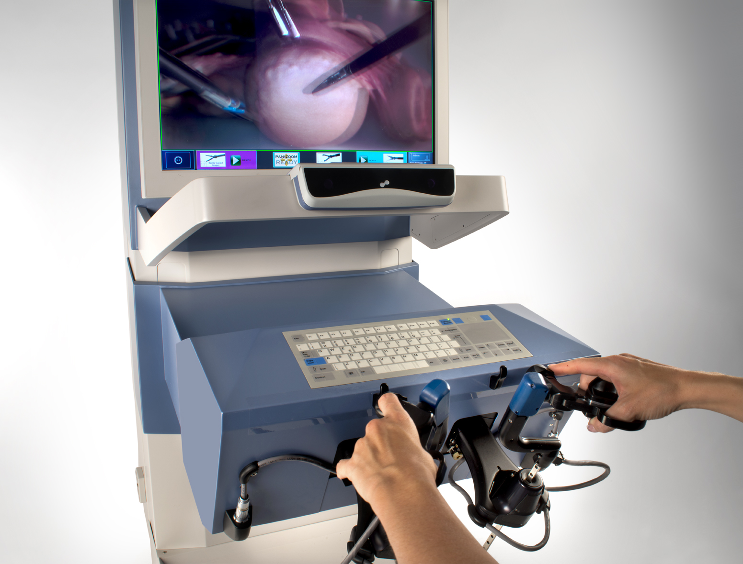



Senhance Surgery
Builds on the foundation of laparoscopy: Highly efficient operations with minimal additional docking time or change to technique
Robotic precision: Performing precise, complex surgery in a more minimally invasive manner
Comfortable ergonomics: Increased comfort and reduced strain for the surgeon
The security of haptics: Safe management of the operation by retaining sensing of touch
Eye-sensing camera control: Increases surgeon control over vision and multiple instruments
Advanced technology with responsible economics: Managing operative costs effectively

Slide 12
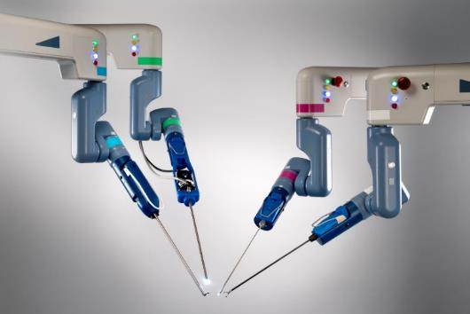
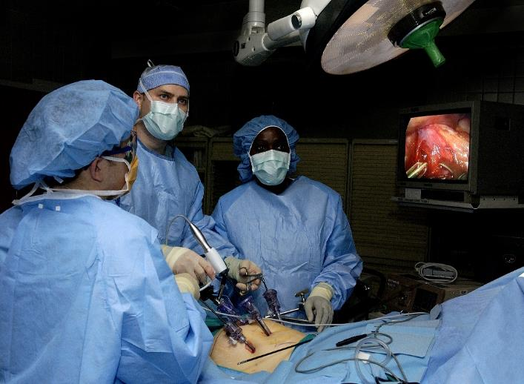
Senhance – Leveraging Laparoscopic Experience
Builds on the foundation of laparoscopy: Highly efficient operations with minimal additional docking time or change to technique
Multi-port system
Laparoscopic motion
Utilizes standard laparoscopic trocars
5mm instruments
Force sensing for minimal torque

Slide 13
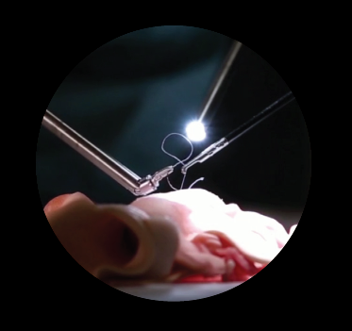
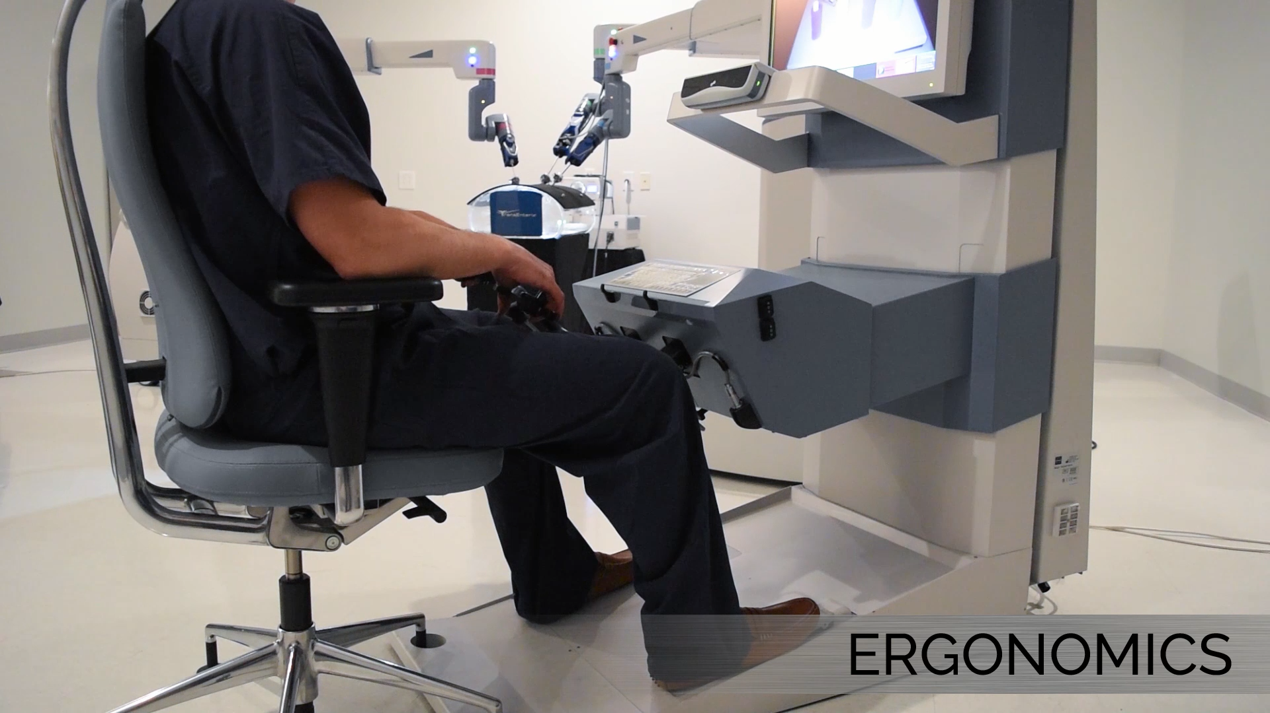
Senhance – Robotic Benefits
Robotic precision: Performing precise, complex surgery in a more minimally invasive manner
Scaled motion
Tremor filtration
Articulating instrument options
HD3D vision
Small incisions for minimal trauma (5-mm instruments)
Comfortable ergonomics: Increased comfort and reduced strain for the surgeon
Seated at console
Easy hand repositioning
Ability to pause
Stable camera
Stable instruments

Slide 14
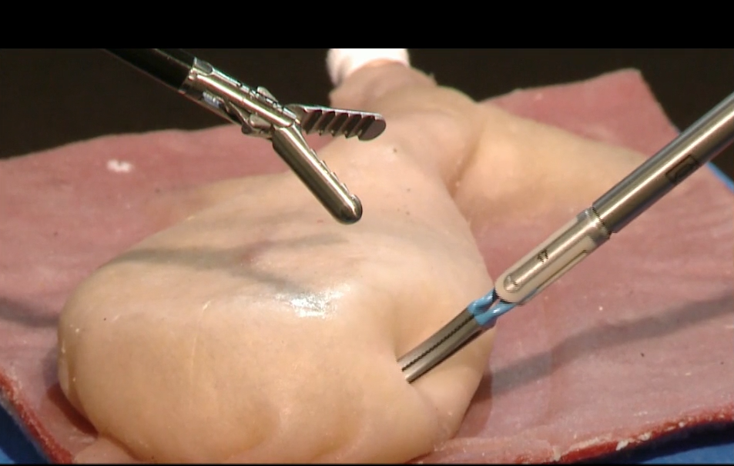
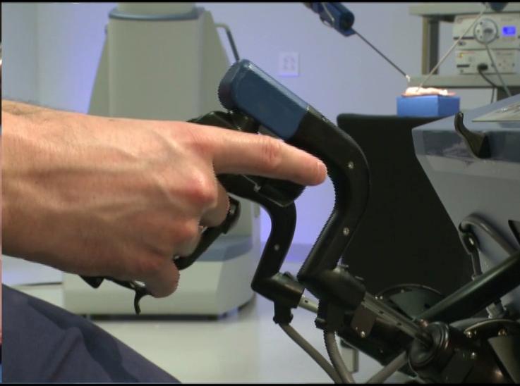
Senhance – Haptic Feedback
The security of haptics: Safe management of the operation by retaining sensing of touch
Safe management of the operation by retaining sensing of touch:
Provides the surgeon with critical safety awareness of objects in and out of field of view
Force-based instrument fulcrum for minimal torque on incision

Slide 15
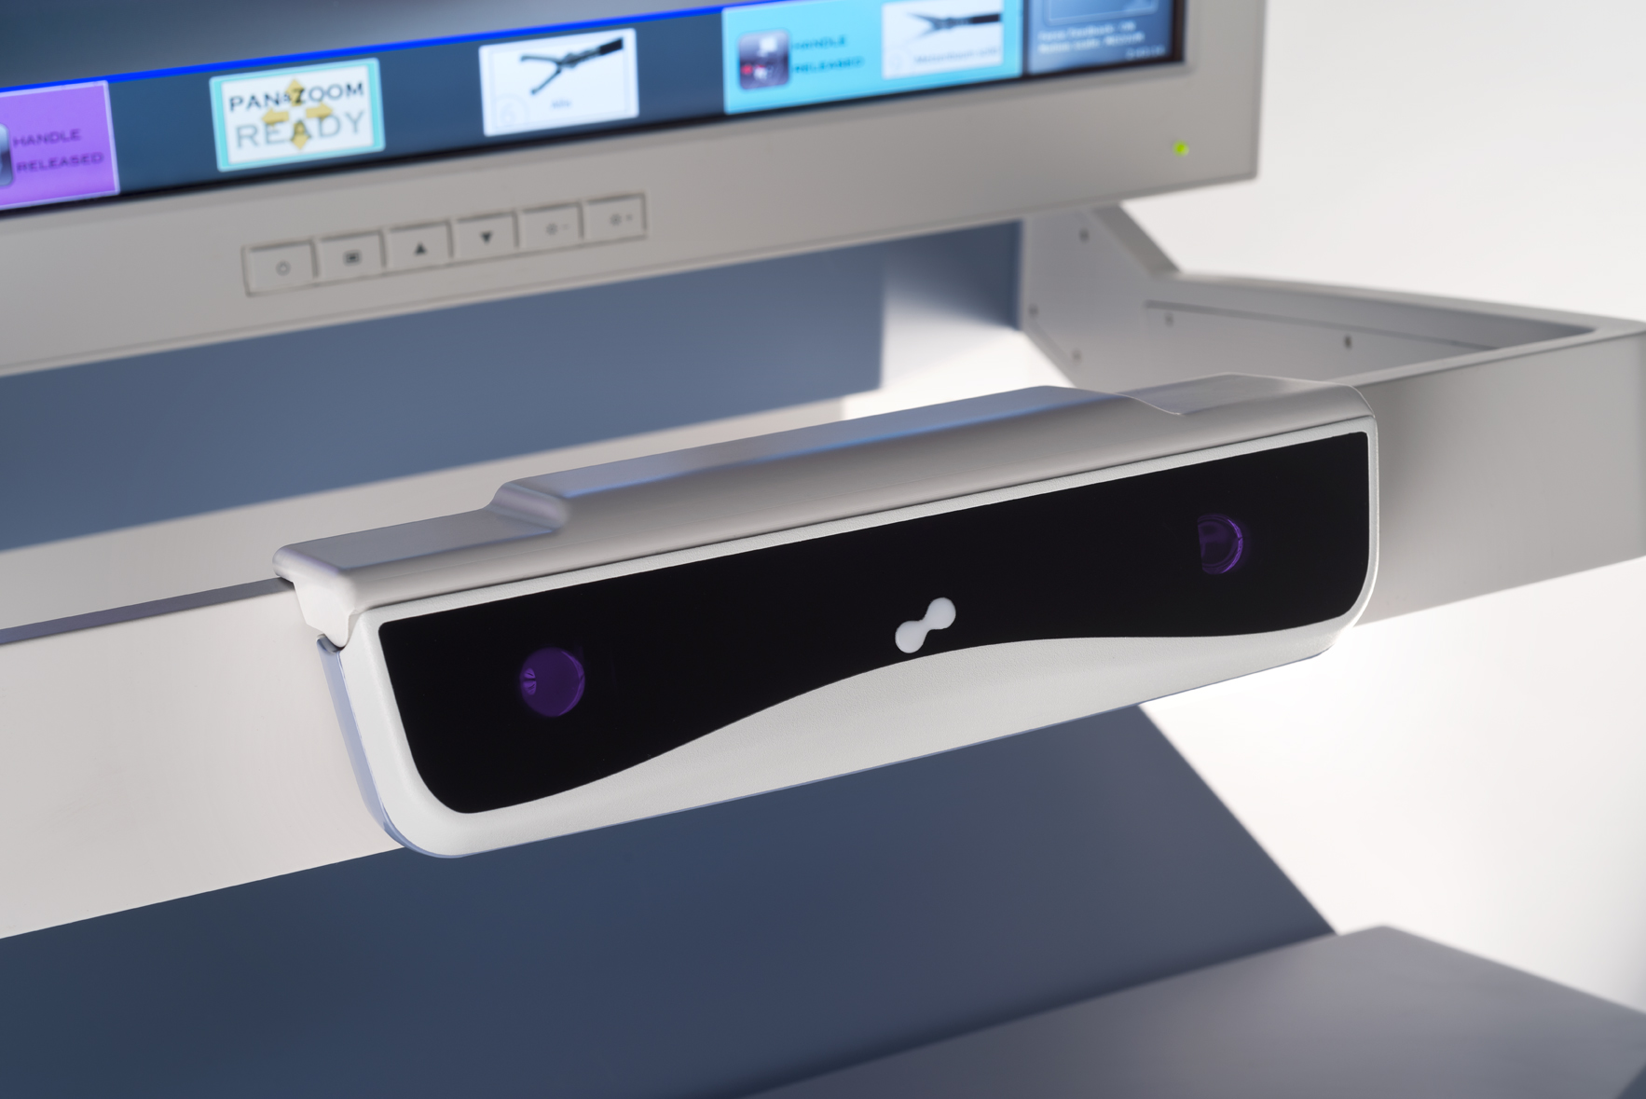
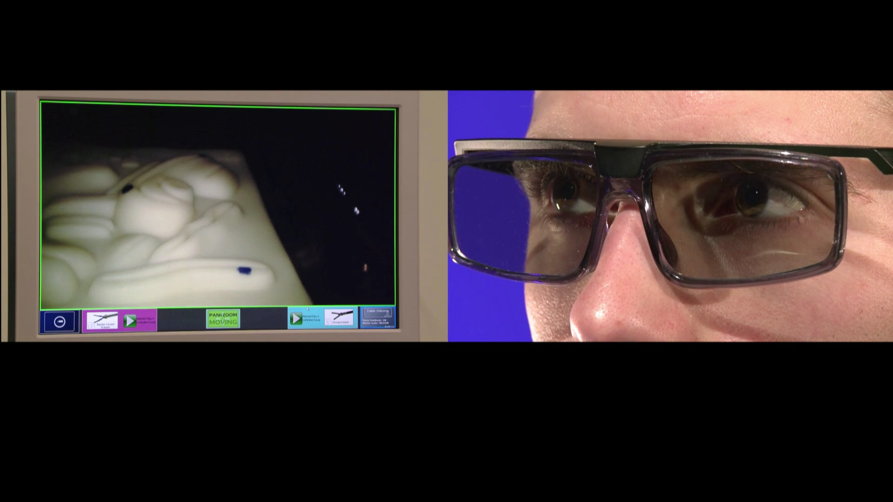
Senhance – Eye-Sensing Camera Control
Eye-sensing camera control: Increases surgeon control over vision and multiple instruments
Surgeon controls camera by moving eyes & head
Allows surgeon to control camera and two instruments simultaneously
Improves procedure workflow
Up/Down/Left/Right/Zoom in/Zoom out

Slide 16
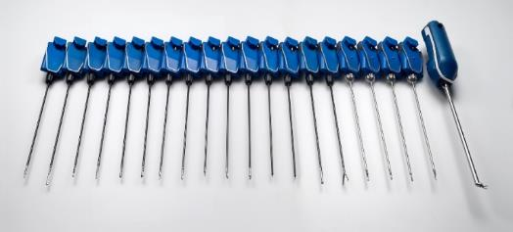
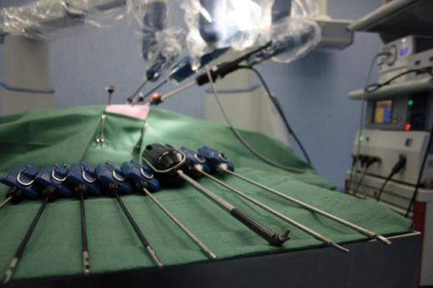
Senhance – Responsible Economics
Advanced technology with responsible economics: Managing operative costs effectively
Reusable instruments
Minimal disposables/case
Fast set up and instrument exchange
Leverage existing hospital infrastructure
Access to robotics, but with costs similar to laparoscopy

Slide 17
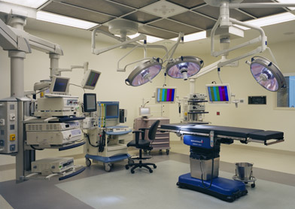
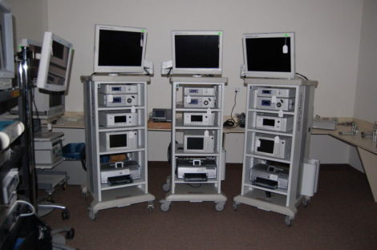
Open Architecture Leverages the True Hospital Ecosystem
Advanced technology with responsible economics: Managing operative costs effective
Hospitals make major investments in existing OR beds, endoscope systems, imaging technologies
Surgeons have developed strong preference for many of these technologies
We have enabled interoperability with existing surgical technologies
Notes:
You can say Stryker and Novodaq, but I’m not going to add it to the slide.

Slide 18
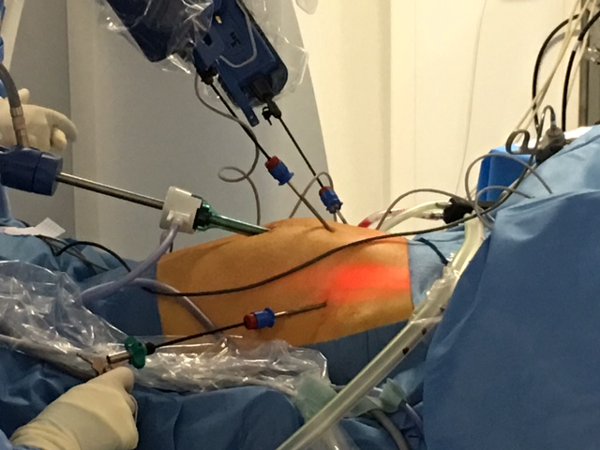
Reducing Invasiveness Robotic Microlap
Introducing the first robotic microlap 3mm system
Enabling virtually scarless surgery
Using robotic precision, tremor filtration and surgeon camera control with microlaparoscopy

Slide 19
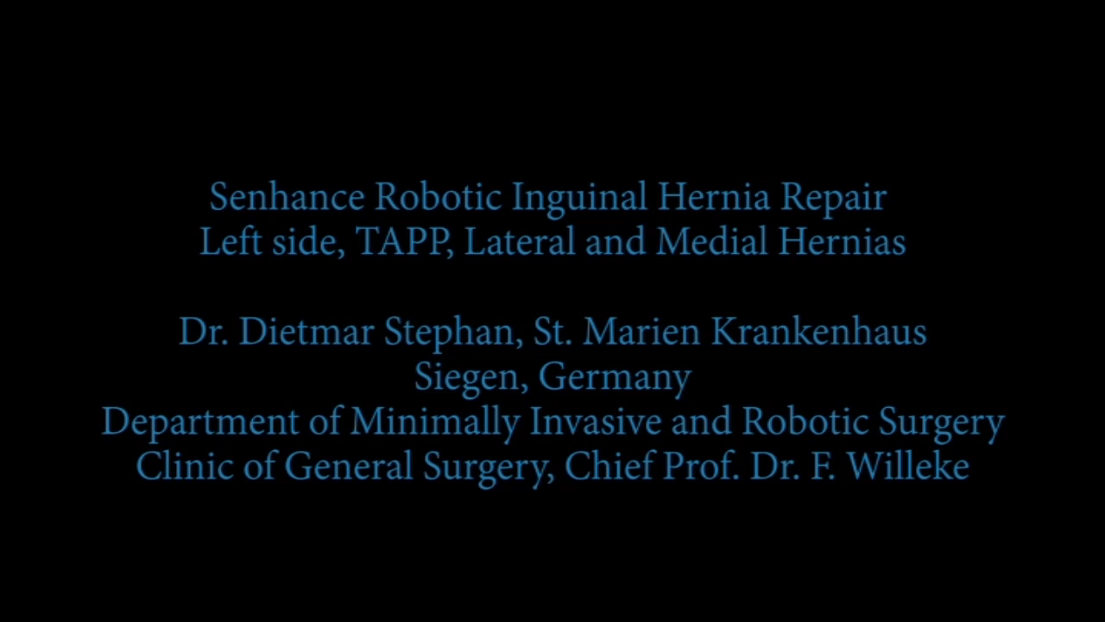

Slide 20
Building Clinical Evidence
    Peer-reviewed published data on procedures for benign and malignant disease and in obese patients
    Surgeons cite positives of short learning curve & median 7 minute set-up time
    Feasibility, safety profile and procedural economics similar to lap surgery for procedures investigated
Journal Reference | Patients | Study Findings
In process – hernia | 64 | Positive safety & efficacy profile in hernia repaor, short learning curve and docking time
In process – cholecystectomy | 20 | Positive safety & efficacy profile in cholecystecomy,
Accepted – colorectal | 47 | Positive safety & efficacy profile in colorectal
Fanfani F, et al. Surg Endosc. 2015 | 146 | Positive safety & efficacy profeil in a range of gynecologic surgical procedures
Fanfani F, et al. J Minim Invasive Gynecol. 2015 | 80 | Similar safety & efficacy profile to laparoscopy in hysterectomy
Rossitto C, et al. Int J Med Robot. 2016 | 81 | Robotic benefits with responsbile economics for the laparoscopic hysterectomy
Gueli Alletti S, et al. J Minim Invasive Gynecol. 2015 | 43 | Similar safety & efficacy profile to laparoscopy for early-stage endometrial cancer
Gueli Alletti S, et al. J Minim Invasive Gynecol. 2015 | 10 | Positive safety & efficacy profile in ovarian cyst enucleation
Rossitto C, et al. J Robot Surg. 2016 | 10 | Positive safety & efficacy profile in obsese hysterectomy patients
Notes:
The early clinical data published is promising: showing application in benign and malignant conditions, as well as in obese patients. The docking, or robotic specific operative time, has been shown to be quite fast with a median of 7 minutes in the largest series, which includes the learning curve. The authors are concluding the device to be feasible and safe with procedural economics that are favorable.

Slide 21
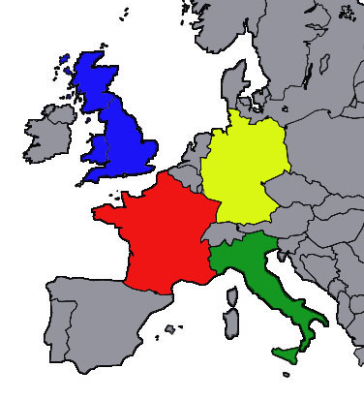






Initial Global Clinical Sites
Imperial College, St. Mary’s
London, England
St. Marien-Krankenhaus Siegen
Siegen, Germany
Universitaetsklinikum Hamburg – Eppendorf (UKE)
Hamburg, Germany
C.H.U. ST Etienne
Saint-Etienne, France
Humanitas University
Milan, Italy
Policlinico Gemelli
Rome, Italy
Saitama Medical University
Hidaka- City, Japan
Notes:
The Senhance is now in clinical use in a growing number of worldwide sites across Europe and Japan.

Slide 22
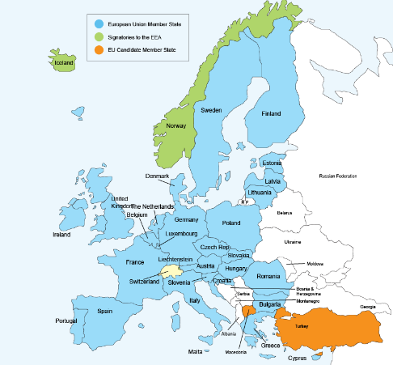
Commercial Activity
Strong foundation established
  Direct sales team covering Germany, France & UK
  Distributors and agents covering Australia, New Zealand, Taiwan, Kuwait, UAE, Austria, Switzerland, Italy
  US sales team hiring begun with 9 field based reps already onboard
Sales activities
  Italian first sale Q3 ’16
  German first sale in Q1 ’17
  Japan first sale Q2 ‘17
  Additional systems placed with option to buy
  12-18 month sales cycle
US FDA clearance expected in 2017

Slide 23
2017 Key Priorities
Prepare for U.S. launch pending FDA clearance with focused market development activities
Continue to demonstrate clinical success across multiple specialties and procedures
Continued focus on commercialization efforts in CE Mark countries
Obtain Senhance US 510(k) clearance by year end

